Slide 1
Asymmetric Space Weathering and Impact Gardening on Lunar Crater Walls
Kilho Baek¹, Sungsoo S. Kim¹, and Chae Kyung Sim^{2,3}
¹Kyung Hee University, Korea
²Korea Astronomy and Space Science Institute (KASI)
³Korea National University of Science and Technology (UST)

Slide 2
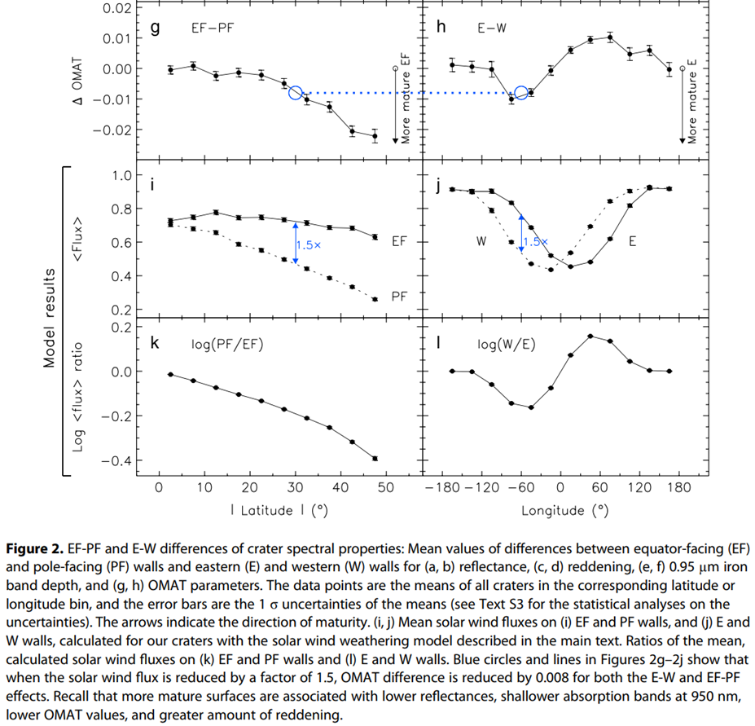
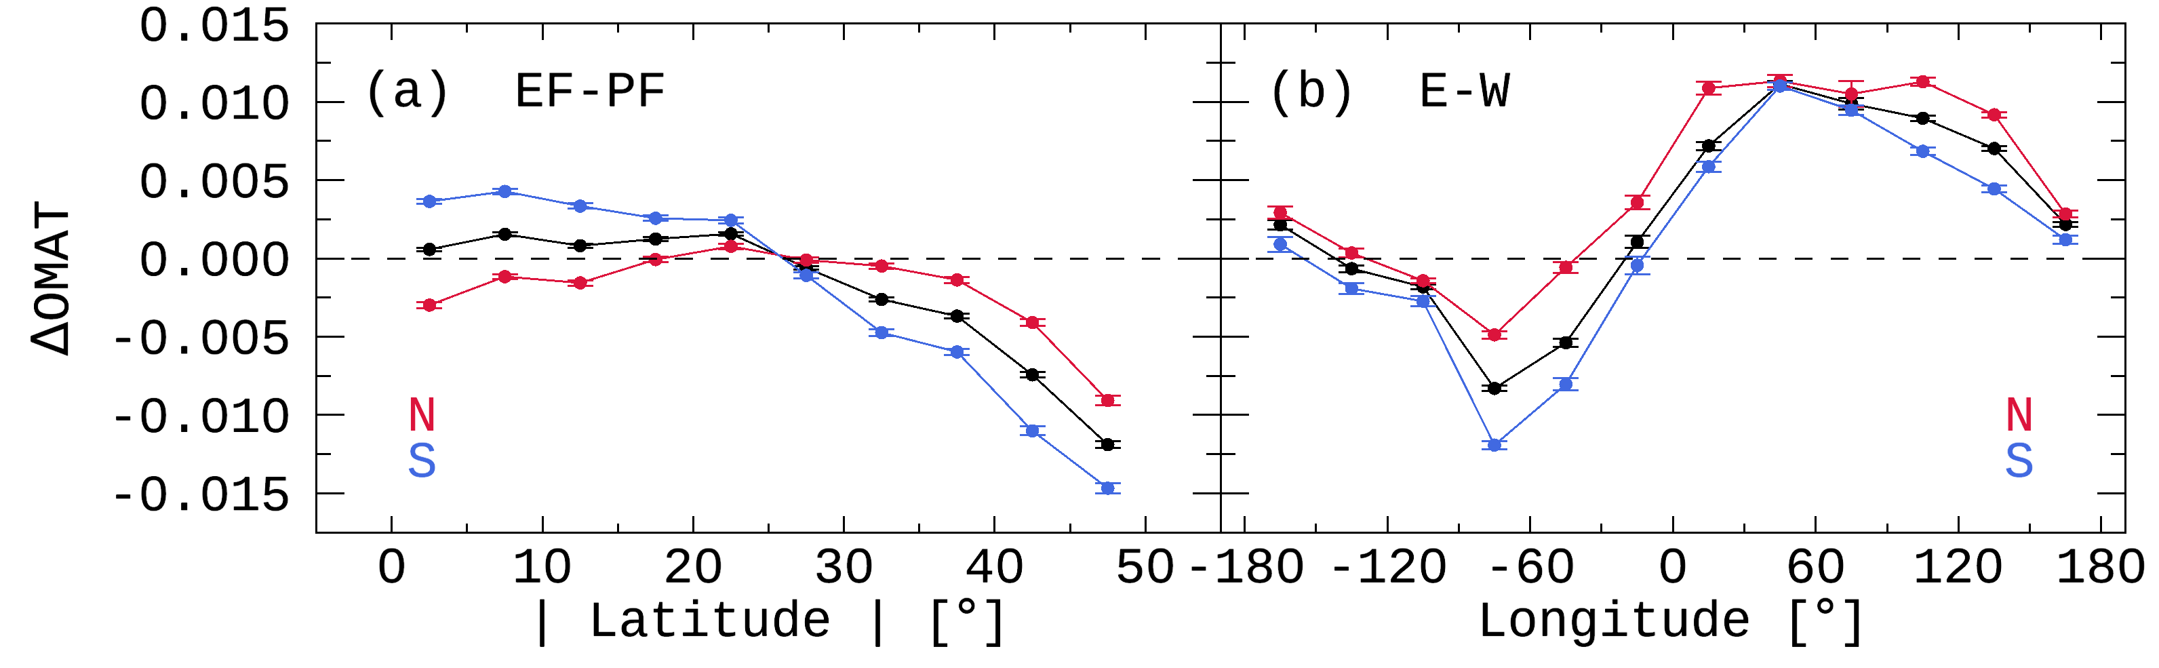
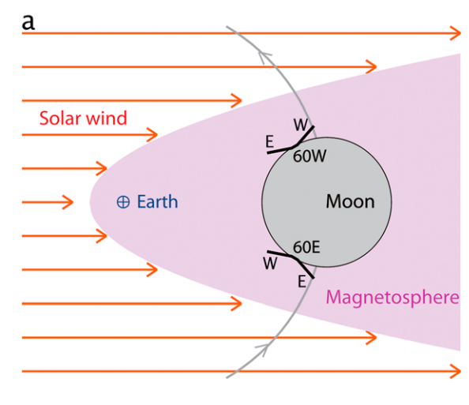
Overview
Sim et al. (2017) GeoRL
This Study
The latitudinal and longitudinal trends
analyzed by dividing into the N and S hemispheres
Hemispheric asymmetry
Longitudinal offset
Stronger
Flux
N
EF wall
solar wind
PF wall
Space weathering
(solar wind particles)
Impart gardening
(meteoroids)
Same Flux
Lat.
Equator
Notes:
I would like to introduce the latitudinal and longitudinal trends analyzed by dividing into the northern and southern hemispheres.
자료처리 개선(자동화)
Crater 개수 10배 이상 증가
북반구/남반구 분리해서 위도, 경도 경향을 확인
새로 발견한 hemispheric 비대칭에 대하여 발표하고자 한다.

Slide 3
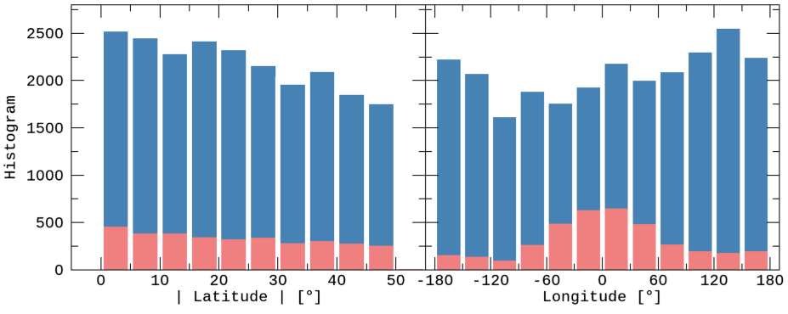
Data
Lunar Impact Crater Database
Global Map
 | LPI (2015) | Robbins et al. (2018)
Total Number | 8716 | ~1.3 million
Main Information | Latitude & Longitude
 | Diameter | Major/Minor-axis
 | Topography | Photometry
Data | DEM (Digital Elevation Map) | Reflectance (415 ~ 1550 nm)
Instrument | LRO LOLA + Kaguya TC | Kaguya MI
Latitude | -60° ~ +60°
Resolution | 512 ppd (≈ 60 m/pixel)
(for the comparative verification)
(for detailed analysis)
Extended Crater Sample
2018 DB
2015 DB
 | Sim et al. (2017) | This study
Database | LPI 2015 |  | Robbins et al. (2018)
Samples | 1,872 | 3,144 | 26,802
Resolution | ~1 km/pixel | ~60 m/pixel
Diameter | 5 ~ 120 km |  | 2 ~ 120 km

Slide 4
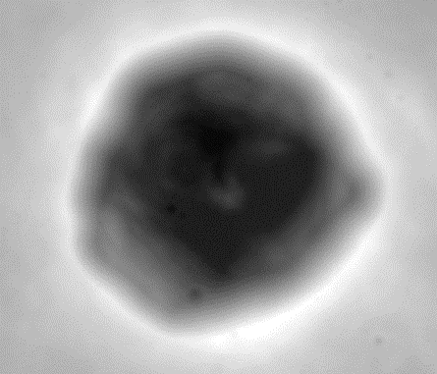
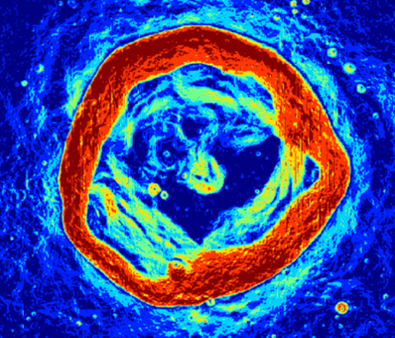
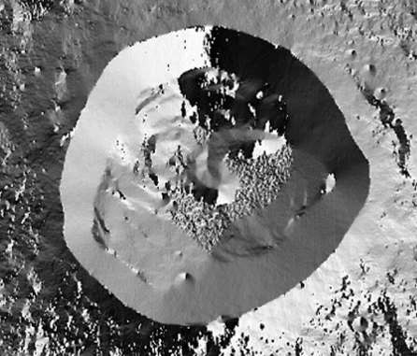
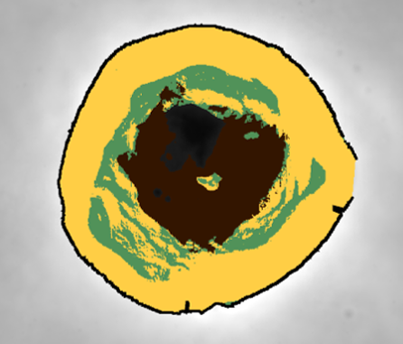
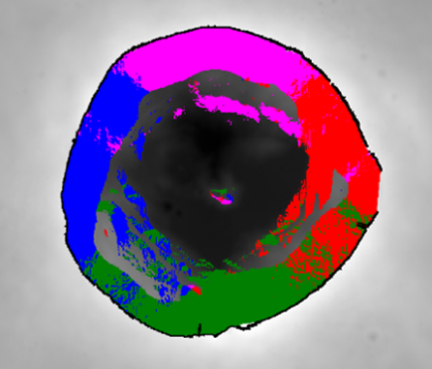
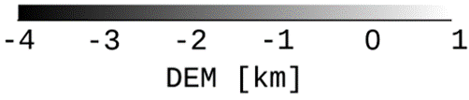
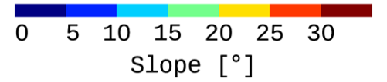
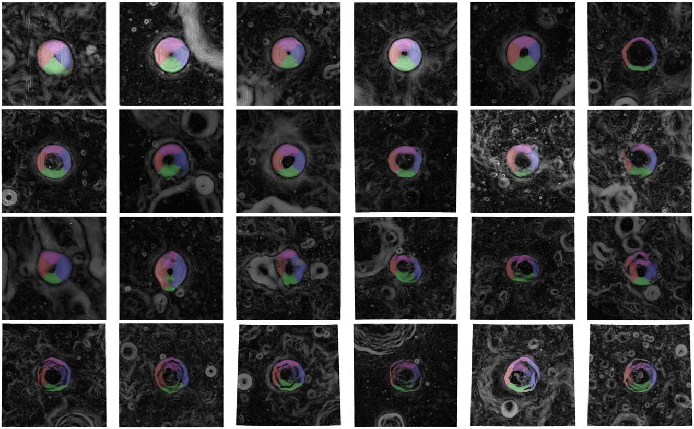
Methods: Data Processing
DEM [km]
Slope [°]
Azimuth Angle [°]
Inner Structures
Wall-Quadrants
rim
3D vector
calculation
DEM
Slope
Azimuth
-4
-2
0
0
10
20
30
-180
0
180
Floor
Terrace
Wall
W
N
S
E
Simple
Complex

Slide 5
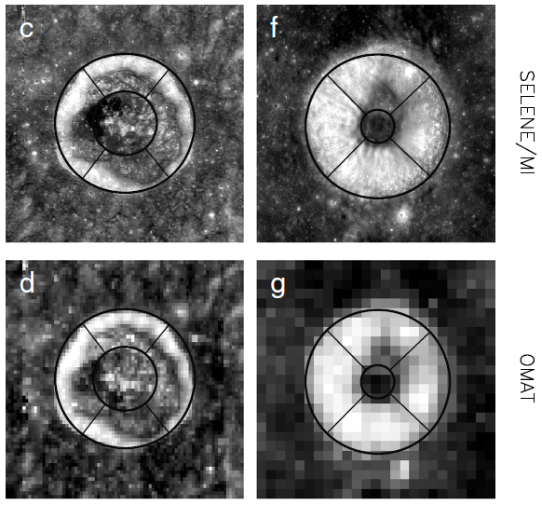
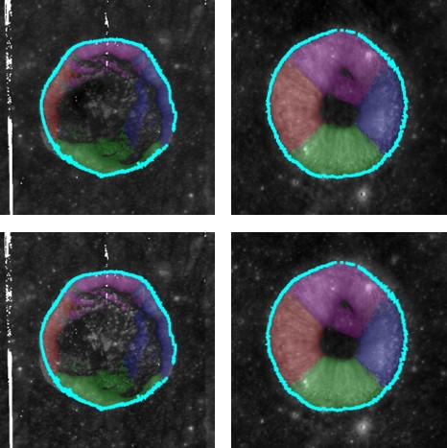
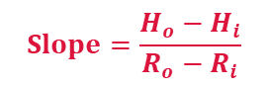
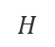
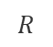
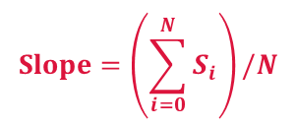
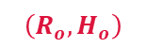
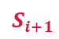
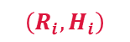

Methods: Improvements
Sim et al. (2017)
This study
① Spatial Resolution of OMAT
① - 1 km/pixel ➔ 60 m/pixel
① - Min. diameter: 5 km ➔ 2 km
② Defining Crater’s Rim
② - More precise and accurate rim
③ Classifying Inner Structure
③ - Floor, terrace, wall (> 15°)
③ - More precise and accurate wall
④ Well-Preserved Crater
④ - Crater’s rim must cover azimuth ④ - of at least 330°
④ - More than 250 pixels on each wall
Slope between two points
Average of all pixels on the walls
$$H$$
$$\left(R_{o}, H_{o}\right)$$
$$Slope=\left(\sum_{i=0}^{N}{S_{i}}\right)/N$$
$$Slope=\frac{H_{o}−H_{i}}{R_{o}−R_{i}}$$
$$S_{i+1}$$
$$\left(R_{i}, H_{i}\right)$$
$$S_{i}$$
$$R$$

Slide 6
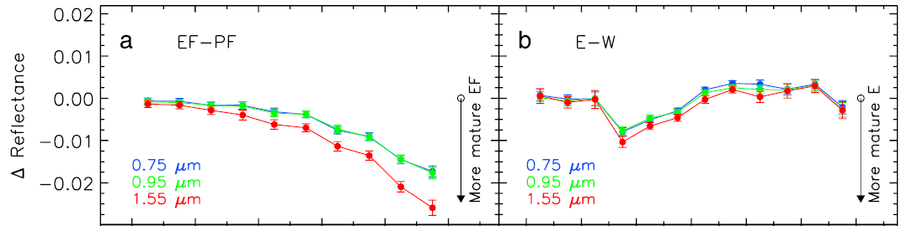
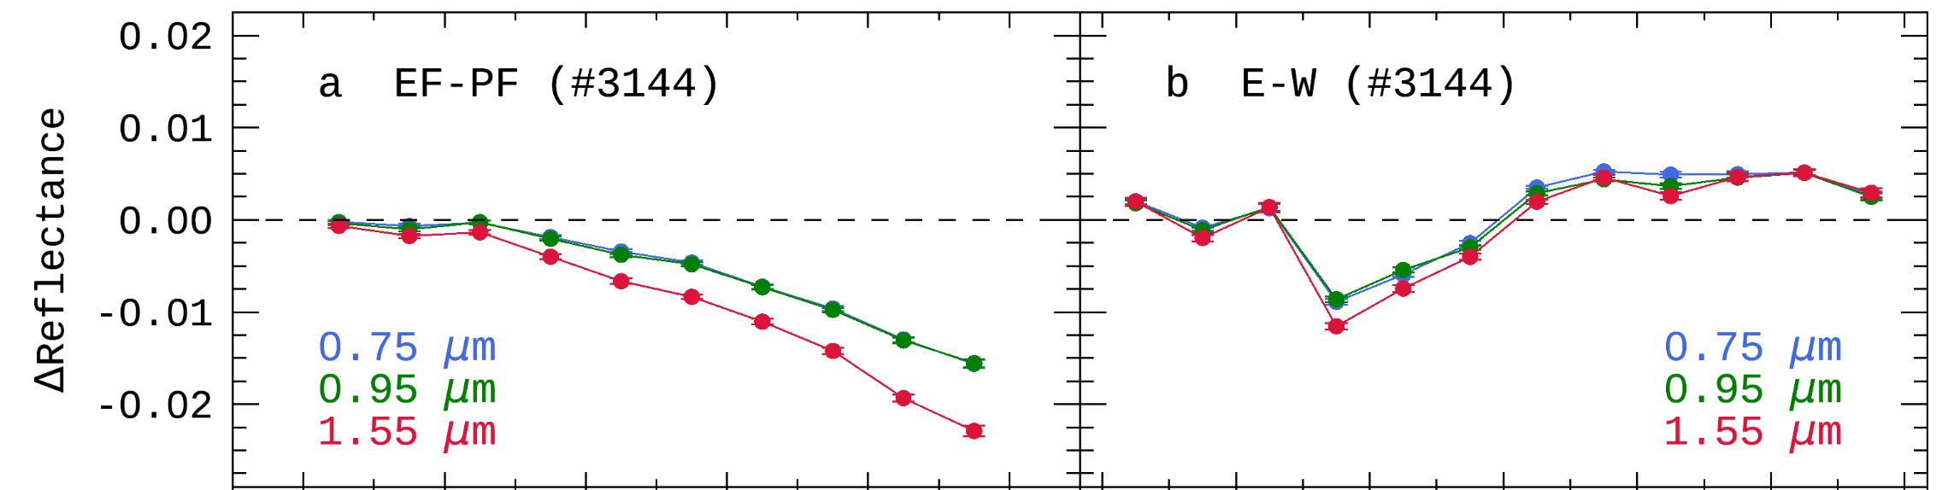
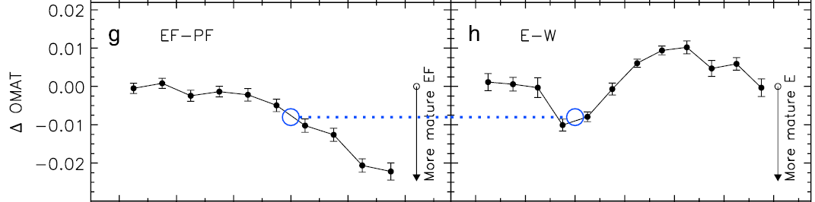
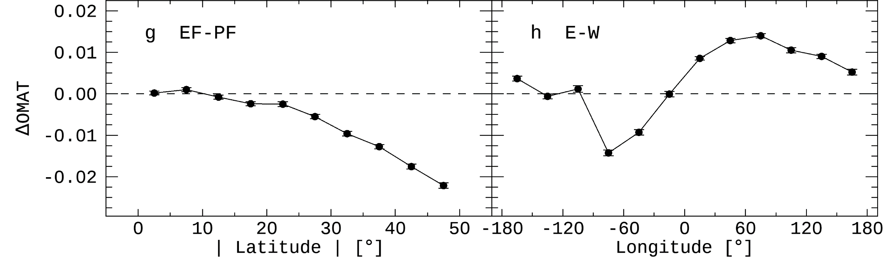
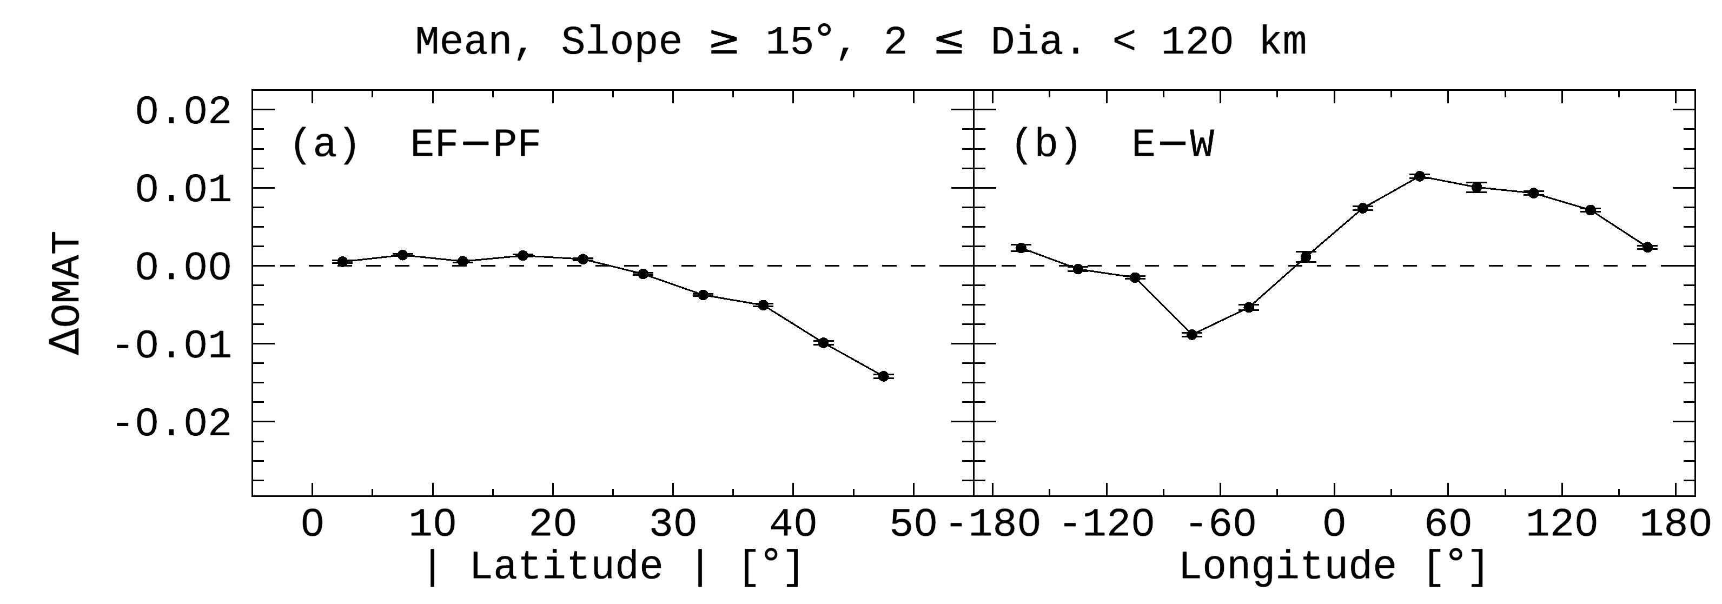
Results: Algorithm Verification
Reproducing the Previous Study [Sim et al. (2017) GeoRL]
Sim et al. (2017): 2015 DB > 1,872 craters
This study : 2015 DB + improved algorithm > 3,144 craters
This study : 2018 DB + improved algorithm > 26,802 craters

Slide 7
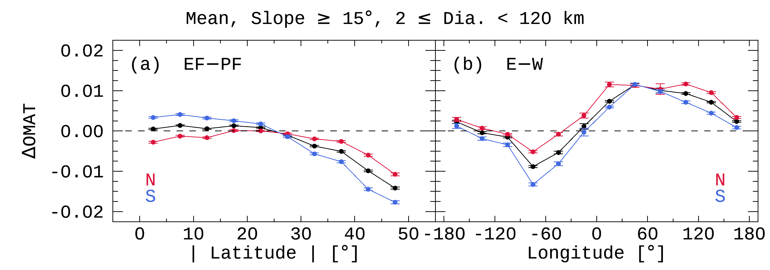
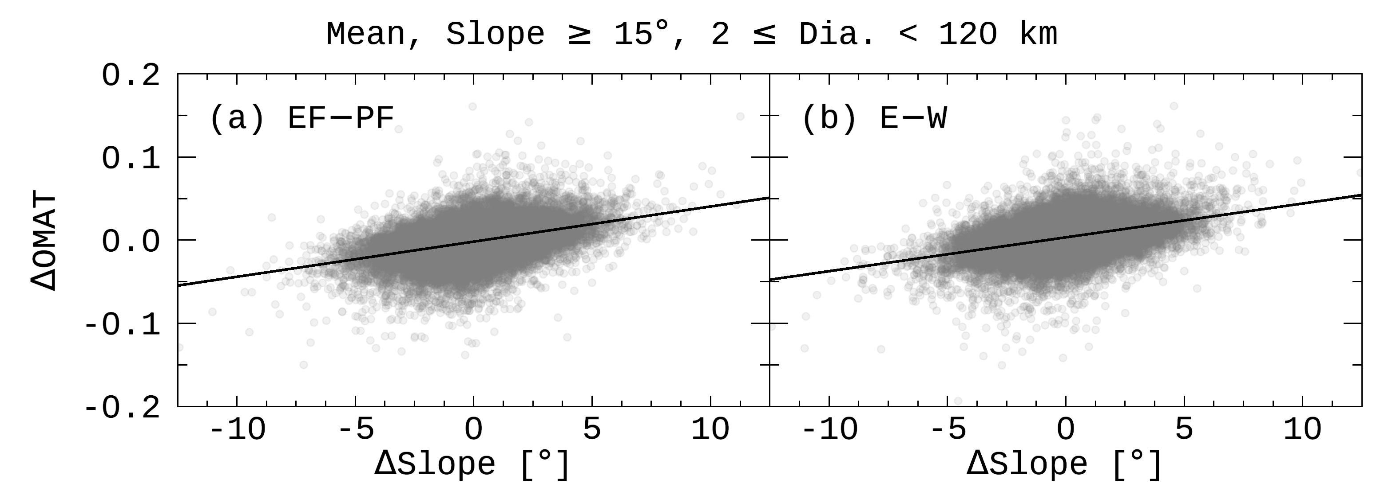
Results: Northern & Southern Hemispheres
① Hemispheric Asymmetry
➔ [Something] makes ➔- S wall fresh near the equator.
① Hemispheric Asymmetry
➔ [Something] makes ➔? S wall fresh near the equator. ➔? N wall mature near the equator.
①
②
①
② Longitudinal Offset
➔ [Something] makes ➔- E wall fresh at any longitude.
② Longitudinal Offset
➔ [Something] makes ➔? E wall fresh at any longitude. ➔? W wall mature at any longitude.
?
[Something] = Meteoroids
crater wall
surface
impact
terrace
➔ A wall with a steeper slope is fresher than the opposite wall.
average Slope
average OMAT
Notes:
태양풍이 아닌 무언가가 남쪽 벽을 어리게 만든다.
태양풍이 아닌 무언가가 동쪽 벽을 어리게 만든다.
positive linear correlation
크레이터 중심에 가까운 벽면은 기울기가 15도 이하이거나 azimuth가 primary crater의 벽면의 azimuth와 반대이기 때문에, 해당 픽셀들은 우리 알고리즘 상에서 벽면에서 제외된다.
positive linear correlation의 기울기가 같기 때문에 EF-PF와 E-W의 hemispheric asymmetry는 같은 원인에 의한 결과일 것이라고 어림잡아 생각함.

Slide 8
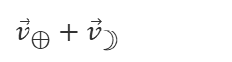
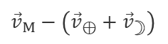
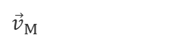
Meteoroid Environment near the Moon
Meteoroids make
① S wall fresher than N wall near the equator.
② E wall fresher than W wall at any longitude.
Anti-Helion Source
Flux: E wall < W wall
Helion Source
Flux: E wall > W wall
${\vec{v}}_{⊕}+{\vec{v}}_{☽}$
${\vec{v}}_{⊕}+{\vec{v}}_{☽}$
${\vec{v}}_{M}$
${\vec{v}}_{M}$
${\vec{v}}_{M}−\left({\vec{v}}_{⊕}+{\vec{v}}_{☽}\right)$
${\vec{v}}_{M}−\left({\vec{v}}_{⊕}+{\vec{v}}_{☽}\right)$
29.80
48.15
47.11
29.80
E
W
N-Pole
29.07
47.38
46.63
29.07
30.51
48.61
47.89
30.51
W
E
E
W
E
W
W
E
W
E
N wall
28.76
46.74
46.74
28.76
29.78
km/s
29.78
km/s
30.80
48.51
48.51
30.80
Moon
Lat.
26.65
E
W
⊕
Earth
E
W
26.65
Equator
Moon
Moon
⊕
Earth
Moon
Moon
Helion
Anti-Helion
W
E
W
E
S wall
29.07
46.63
47.38
29.07
30.51
48.89
48.61
30.51
E
W
E
W
29.80
47.11
48.15
29.80
W
E
W
E
S-Pole
E
W
W
E
1.02 km/s
1.02 km/s

Slide 9
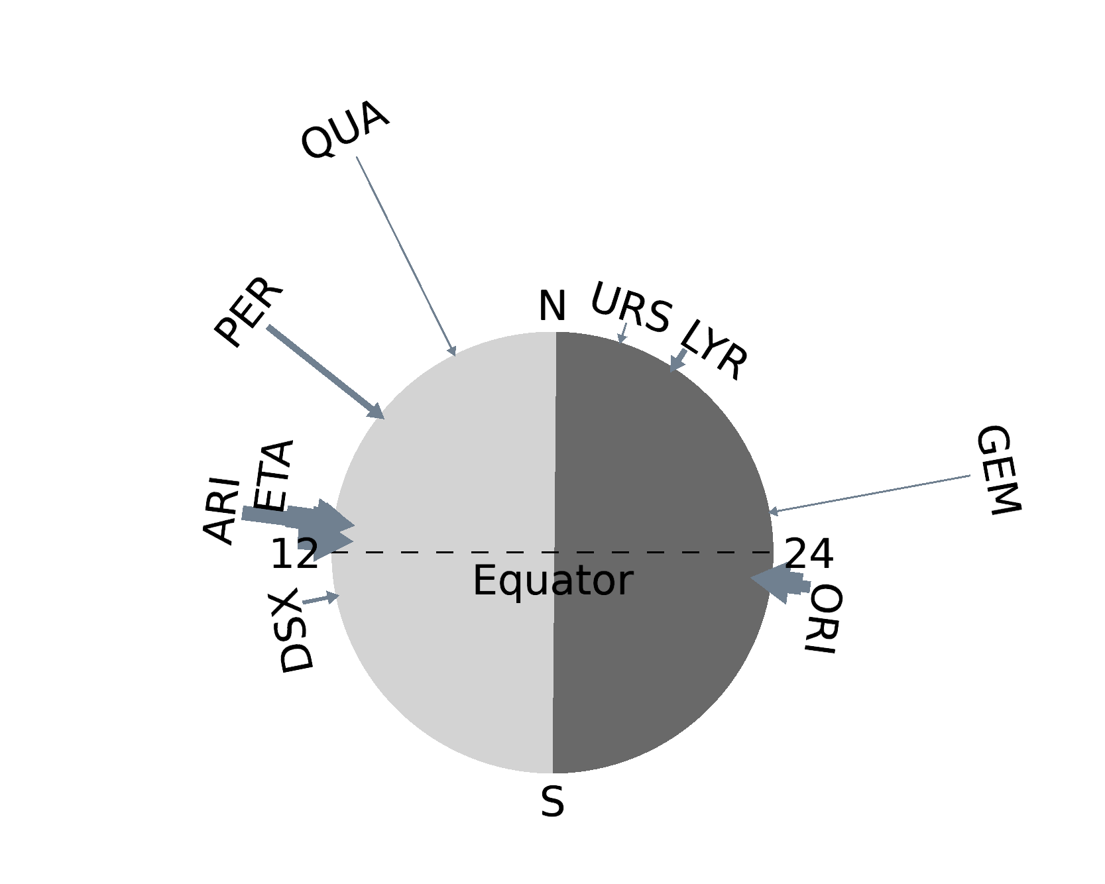
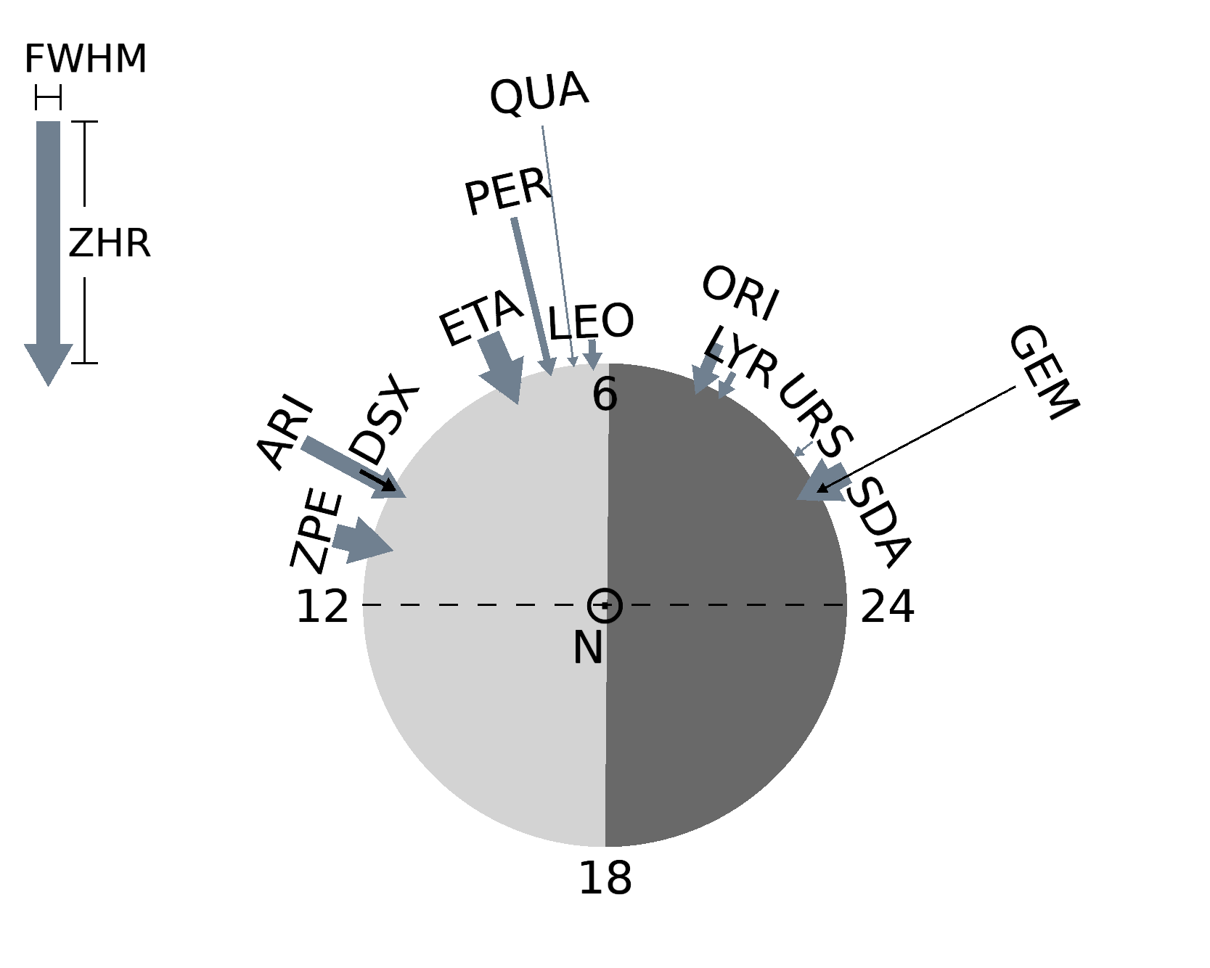
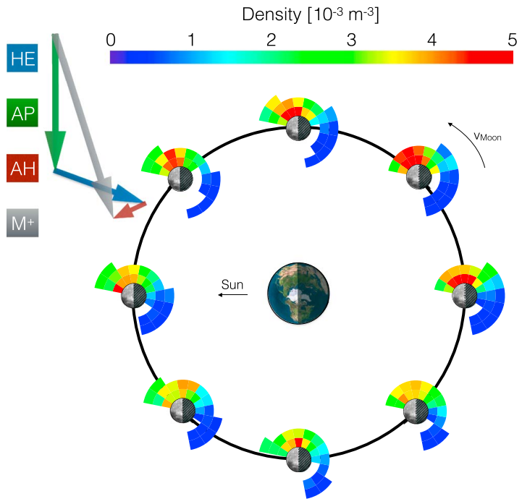
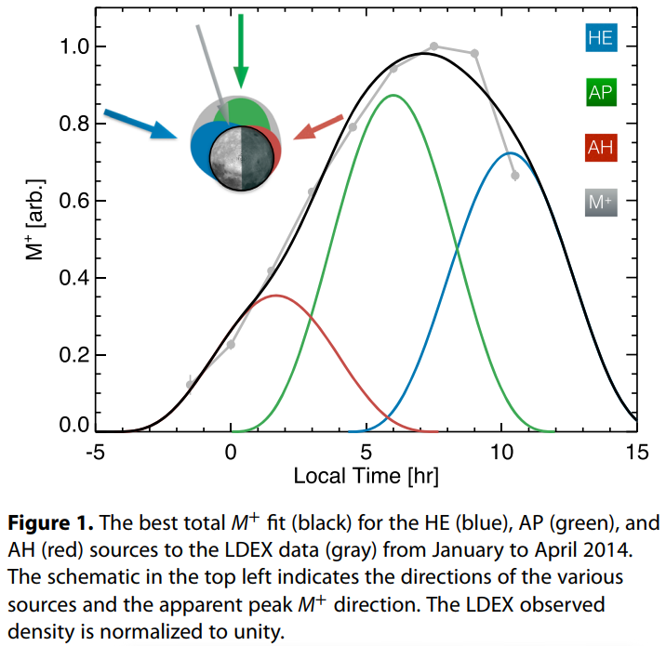
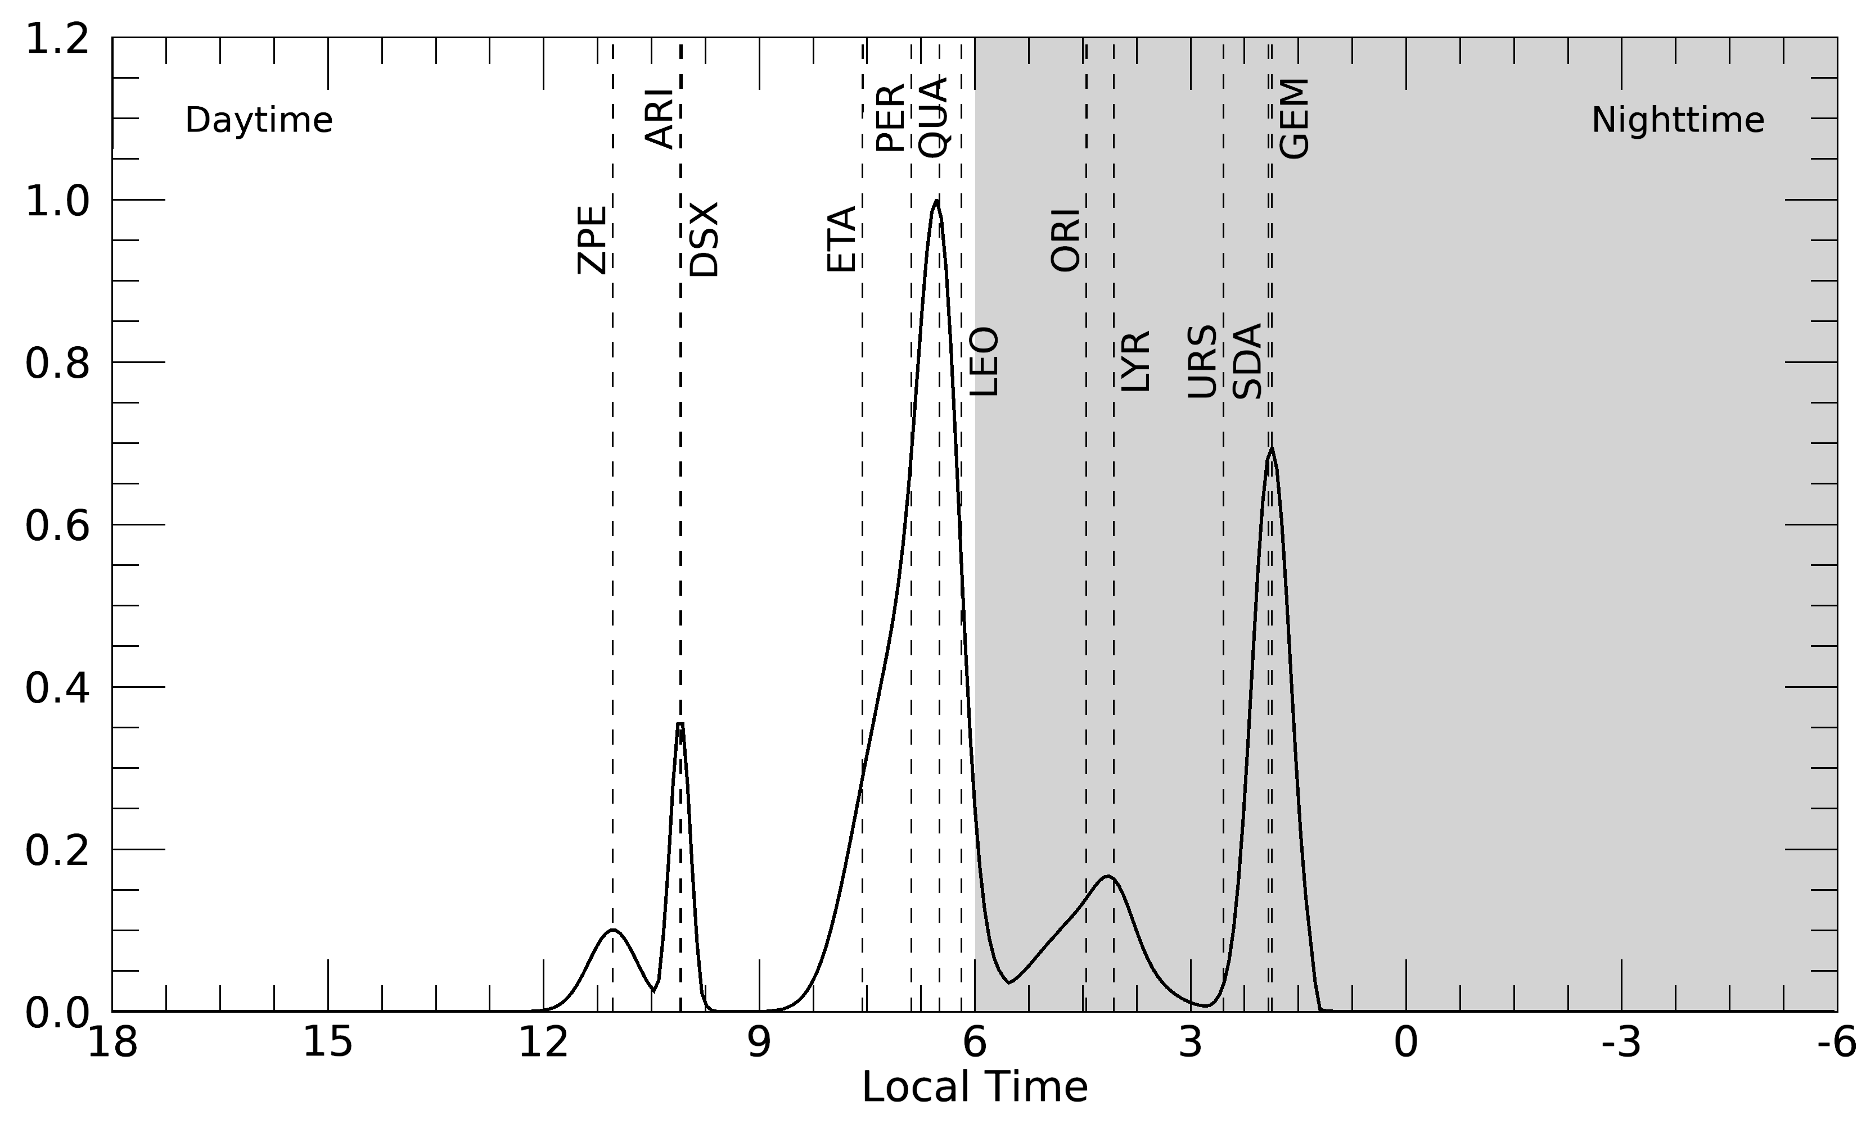
Meteoroid Environment near the Moon
Meteor Showers
Sporadic Meteoroids
Refer to the Tab. 7 of Merisio & Topputo (2023)
Szalay & Horányi (2015) GeoRL

Slide 10
Modeling: Solar-Wind + Meteoroids
Simple Model (Sim et al., 2017)
> Solar-wind particles
> - Earth’s magnetosphere
+ Orbital motion of the Earth
+ - Average speed ≈ 29.78 km/s
+ Sporadic meteoroids (Szalay & Horányi, 2015)
+ - Helion, Antihelion, Apex
+ - Ecliptic lat. the radiant ≈ 0°
+ - Flux: Helion > Anti-Helion
+ Meteor showers (simple assumption)
+ - Local time of the radiant = [12, 24]
+ - Ecliptic lat. of the radiant ≈ 30°
+ - Flux: Helion > Anti-Helion
Apex
W
E
E
W
W
E
W
E
Helion
Anti-Helion
E
W
E
W
Solar wind
29.78
km/s
W
E
⊕
Earth
W
E
Shower
Moon
Moon
Shower
E
W
E
W
Magnetosphere
W
E
W
E
E
W
E
W
W
E
E
W
1.02 km/s

Slide 11
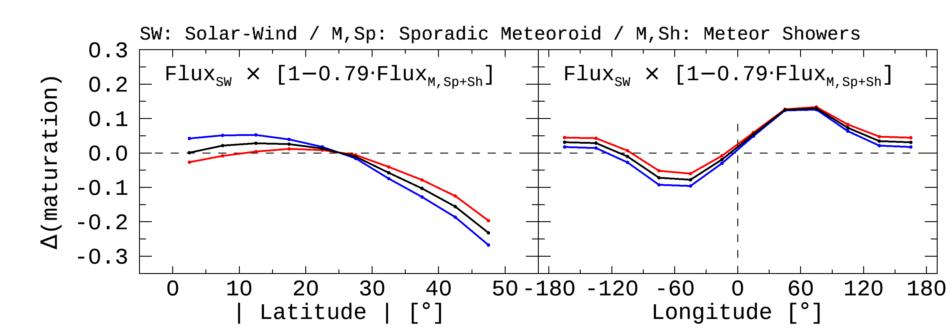
Modeling: Solar-Wind + Meteoroids
Observation
Our Model

Slide 12
Summary
Improvements (1) Data processing has been improved to define realistic features of a crater. (2) The number of craters available for analysis was extended from 1,872 to 26,802. ➔ We ensured statistical significance by reproducing the previous study.
New Findings & Modeling (1) N-S hemispheric asymmetry << Meteor showers (2) Longitudinal offset << Meteor showers & Sporadic meteoroids ➔ We are combining the effects of space weathering by solar-wind and impact gardening by meteoroids
Earth’s orbital motion
Flux: Helion > Anti-helion
Impact Gardening |  | Space Weathering
Meteoroids |  | Solar-Wind Particles | Micrometeoroids
Sporadic Meteoroids | Meteor Showers
Excavation or Gardening (fresh soils come up to the surface) |  | Sputtering (npFe) | Comminution (grain size become smaller) | Sputtering (npFe & mpFe)
refreshment |  | maturation | maturation
This study
Future Work
Notes:
We expect that this results help broaden our perspective of the space environment near the Moon or Earth.
우리는 이 연구 결과가 달 또는 지구 근처의 우주 환경에 대한 시야를 넓히는 데 도움이 될 것이라고 기대한다.

